Slide 1


Network Protocols
Network protocols are essential for communication between computers and devices. They define the rules and formats for data exchange, enabling seamless interaction across diverse networks.

Slide 2

Introduction to Network Protocols
Communication Rules
Data Formatting
They define the structure and format of data packets exchanged over the network.
Network protocols are the rules and standards for communication between devices on a network.
Error Handling
Protocols include mechanisms for detecting and handling errors in data transmission.

Slide 3
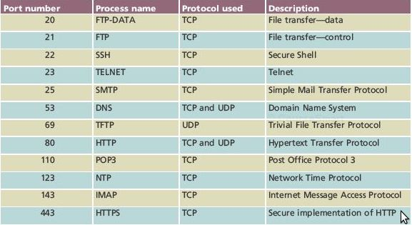

Slide 4

Common Network Protocols
HTTP
SMTP
Hypertext Transfer Protocol (HTTP) is used for transferring web pages and other files over the internet.
Simple Mail Transfer Protocol (SMTP) is responsible for sending emails between servers.
FTP
DHCP
File Transfer Protocol (FTP) enables the transfer of files between computers on a network.
Dynamic Host Configuration Protocol (DHCP) automatically assigns IP addresses to devices on a network.

Slide 5
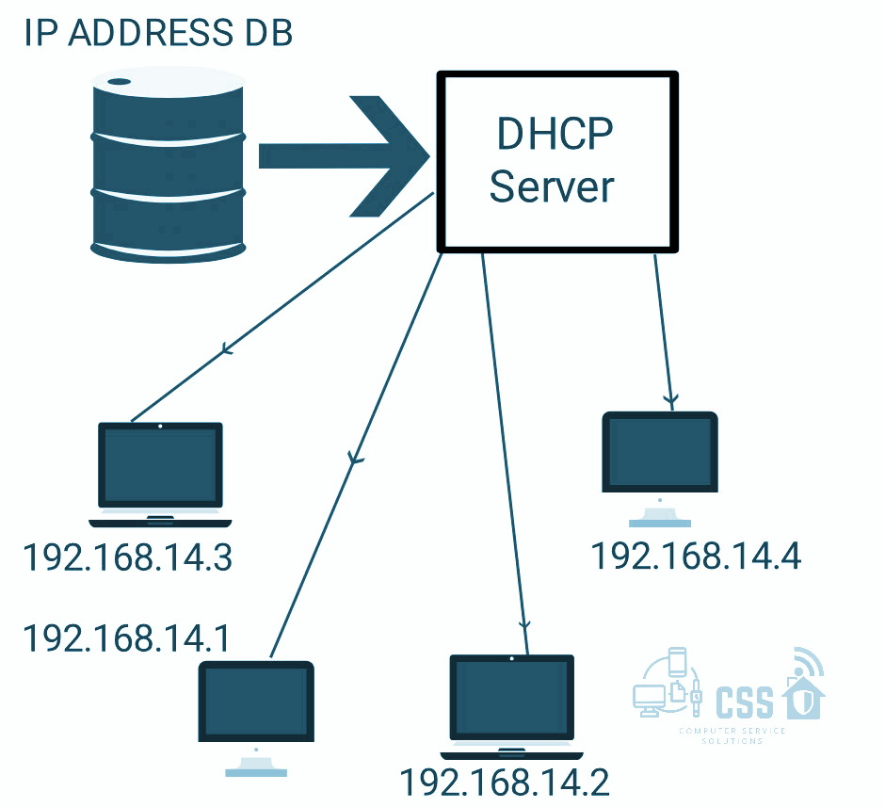
DHCP
1
Request
A device requests an IP address from the DHCP server.
2
Offer
The DHCP server offers an available IP address to the device.
3
Request
The device requests the offered IP address from the server.
4
Acknowledgement
The DHCP server acknowledges the request and assigns the IP address.

Slide 6
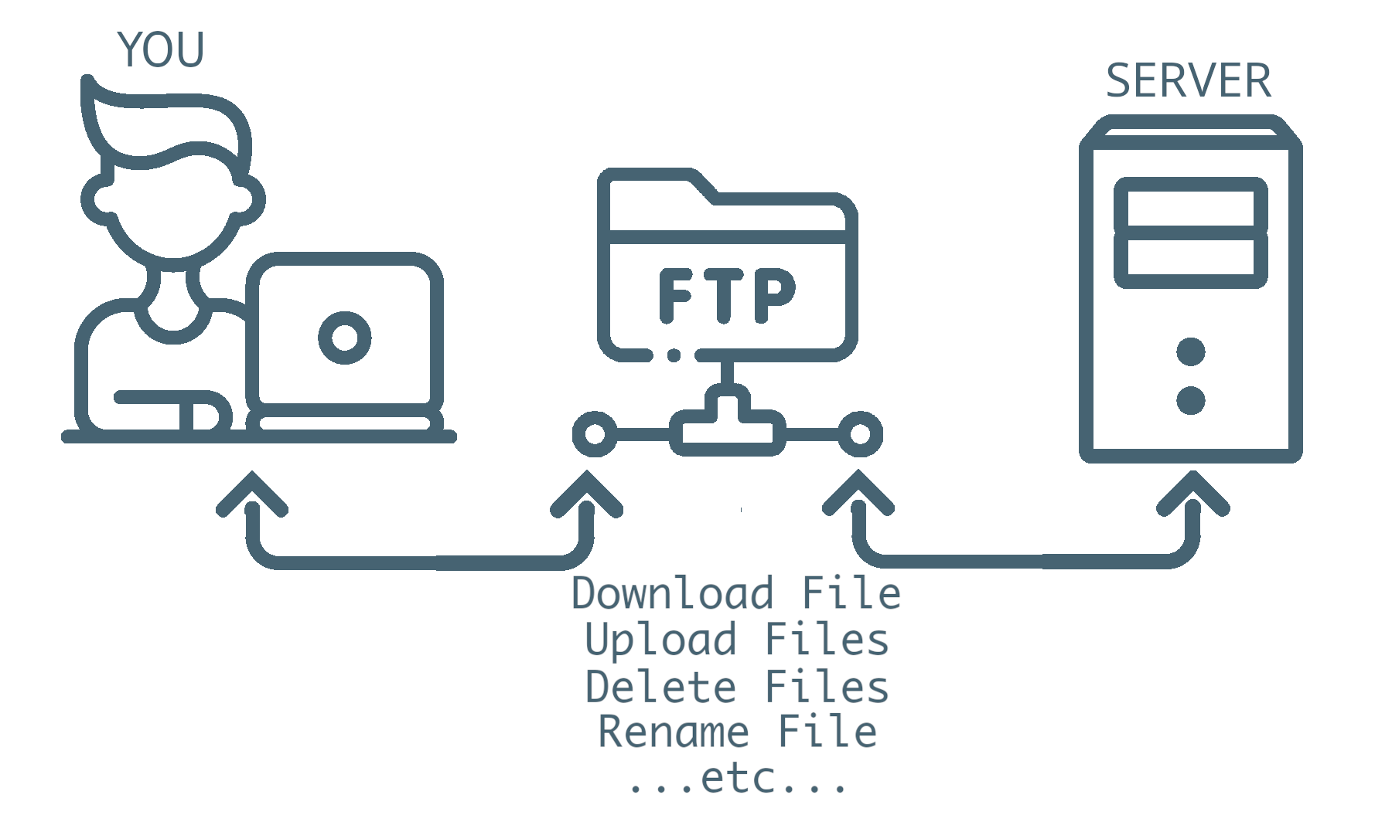
FTP
Uploading Files
Downloading Files
Clients can upload files to a server using FTP, enabling sharing of documents, software, and other data.
Clients can download files from a server using FTP, allowing access to remote files and resources.

Slide 7




SMTP, POP3 and ICMP
SMTP
Sends emails between servers.
POP3
Retrieves emails from servers.
ICMP
Sends error messages and network status information.

Slide 8
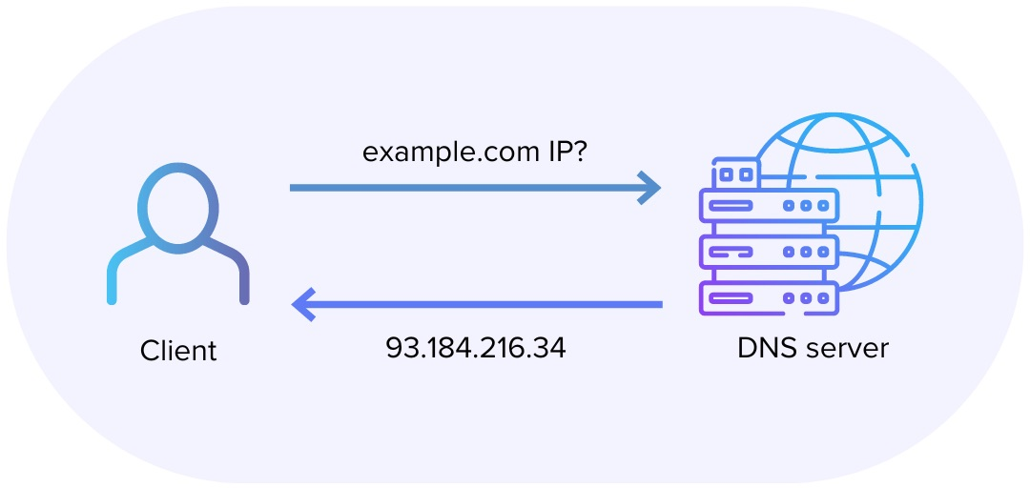




DNS
Request
Cache Check
Recursive Query
Response
A device sends a request to a DNS server for a specific website's IP address.
The DNS server checks its cache for the requested IP address.
If the IP address is not in the cache, the DNS server queries other DNS servers in a recursive manner.
Once the IP address is found, the DNS server responds to the device.

Slide 9
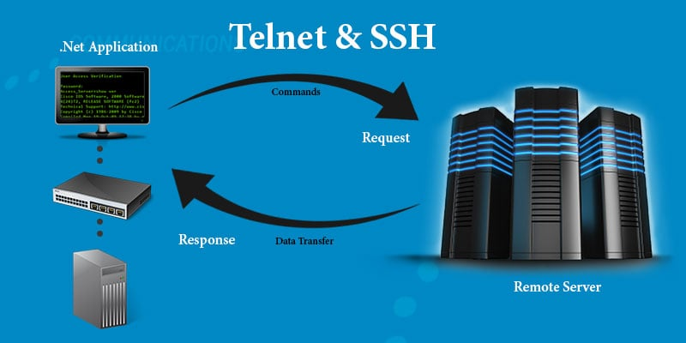
SSH and Telnet
SSH
Telnet
Secure Shell (SSH) provides a secure and encrypted connection for remote access and file transfers. It uses public-key cryptography for authentication, ensuring secure communication.
Telnet is an older protocol that transmits data in plain text, making it vulnerable to eavesdropping. It is often used for simple remote access but lacks security features.

